Slide 1
CSSE 332 User-space Threading
Thursday, November 29, 2018

Slide 2
Agenda
What is user-space thread?
What are disadvantage/advantages of user-space thread?
How to solve one of the disadvantages – preemption?

Slide 3
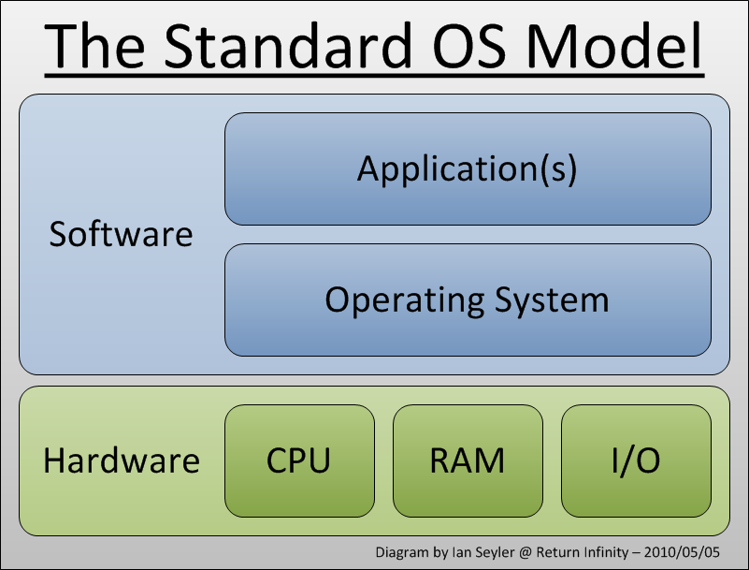
Intro to user-space thread
User space v.s. Kernel space

Slide 4
Intro to user-space thread (cont.)
Process v.s. Thread

Slide 5
How to switch between 2 “threads” (swapcontext)
Imagine we are running one “thread” on CPU but then we want to switch to the other.
What are the things we need to do?
Work in a group of 2-3 to get them all (4-5 things).

Slide 6
How to switch between 2 “threads” (cont.)
Update program counter – what is next code run.
Update the stack pointer – where is my own stack.
Store the current registers into memory – remember what’s in the current context now
Restore the saved state of the computation registers – restore the previous context.

Slide 7


Properties of user-space thread
User-level threads does not require modification to operating systems.
A thred can have a distinct memory space from other threads in the same process.

Slide 8
Disadvantages of user-space threads
They can't have a distinct memory space – all user-space threads share the same memory
They can access to each other's memory within a process (different from processes)

Slide 9
Properties of user-space thread
They are comparatively cheap to make compared to OS managed threads
The application has complete control of how the threads are scheduled

Slide 10
Properties of user-space thread (cont.)
They can run simultaneously on multiple CPUs if my system has multiple CPUs

Slide 11
Disadvantages of user-space thread (cont.)
They can't run simultaneously on multiple CPUs if available.
They are just 1 process from the OS's perspective.

Slide 12
Properties of user-space thread (cont.)
If one userspace thread does something that causes a wait (e.g. requests something from memory, disk, the network), all the other userspace threads can still run.

Slide 13
Disadvantages of user-space thread (cont.)
If one user-space thread causes a wait (e.g. requests something from memory, disk, the network) the OS will de-schedule all the userspace threads.
If a single thread initiates a long system call, every other thread will be blocked for waiting this call.

Slide 14
Properties of user-space thread (cont.)
They are more cross-platform consistent than OS threads
They don’t have to manually yield – we have a way to take the control back.

Slide 15
Disadvantages of user-space thread (cont.)
If they run to trouble (e.g., into an erroneous loop), there is no way to pull them out.
Drive a car with no brake

Slide 16
Interrupt
It basically forces the CPU to do the behavior of a function call (save registers/adjust program counter/etc.), though the current program doesn’t say so – Preempt.
User-space can’t, but OS thread can.

Slide 17
Interrupt (cont.)
In UNIX, the approach is to use called "signals”.
This will open up a massive can of bugs...er...worms however

Slide 18
Why interrupt is hard
Preempting at arbitrary times is hard
The preemption can occur in strange places...in the middle of library calls like printf, open, and can cause them to fail

